Slide 1

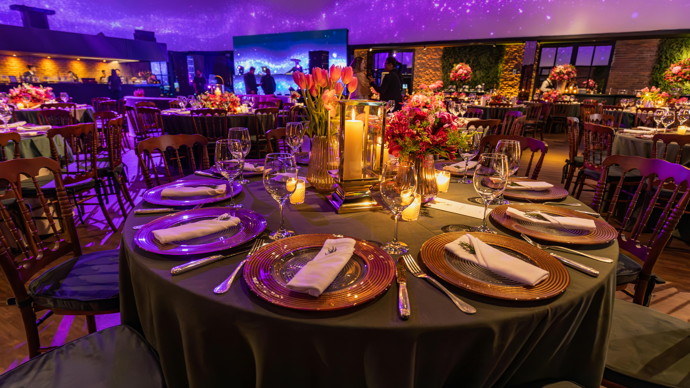

Slide 3
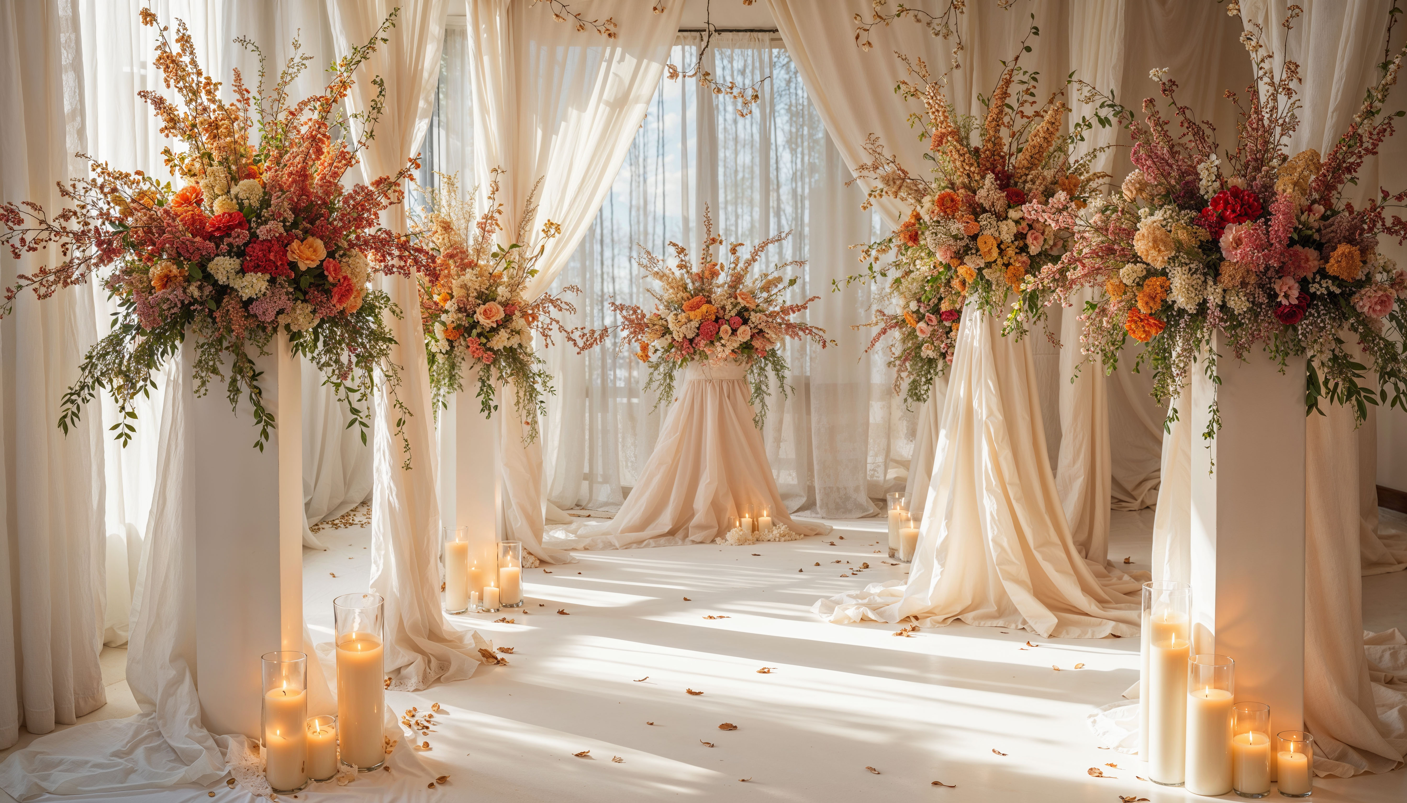
WedWise : Smart Venue Choices
Implies a wise, analytical approach to selecting wedding venues.
- Ruchita Patil
(Presenter)

Slide 4
WedWise : Smart Venue Choices
Implies a wise, analytical approach to selecting wedding venues.
- Ruchita Patil
(Presenter)

Slide 5
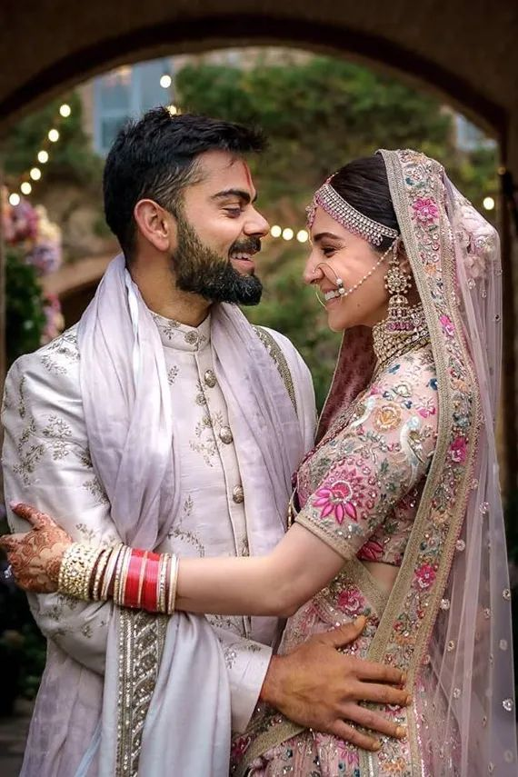

HOW DO I
CHOSE THIS
T PIC ?

Slide 6
HOW DO I
CHOSE THIS
T PIC ?

Slide 7

ABOUT ME
My name is Ruchita Patil, I Have recently completed my Bachelors Of Technology (B.Tech) in Artificial Intelligence from G H Raisoni College Of Engineering And Management, Jalgaon, Maharashtra.
Currently, I am pursuing a Data Science course at Innomatics Research Labs, Pune. I developed a strong interest in coding during my four years of college while learning Python, ML, and DL.
As a passionate AI student, I chose to begin with data science as the first step towards mastering Generative AI.
I am actively building my skills by scraping data from websites, cleaning it, and extracting meaningful and actionable insights.
Here are links to my LinkedIn and GitHub profiles:
www.linkedin.com/in/patil-ruchita
https://github.com/Ruchii151

Slide 8
ABOUT ME
My name is Ruchita Patil, I Have recently completed my Bachelors Of Technology (B.Tech) in Artificial Intelligence from G H Raisoni College Of Engineering And Management, Jalgaon, Maharashtra.
Currently, I am pursuing a Data Science course at Innomatics Research Labs, Pune. I developed a strong interest in coding during my four years of college while learning Python, ML, and DL.
As a passionate AI student, I chose to begin with data science as the first step towards mastering Generative AI.
I am actively building my skills by scraping data from websites, cleaning it, and extracting meaningful and actionable insights.
Here are links to my LinkedIn and GitHub profiles:
www.linkedin.com/in/patil-ruchita
https://github.com/Ruchii151

Slide 9
PROBLEM STATEMENT
Identifying which venue attributes most influence its popularity (measured by user reviews, ratings, prices, or amenities).
Information overload caused by large numbers of listings.
OBJECTIVE
To identify key factors that influence the popularity of wedding venues.
To generate actionable insights that can improve venue recommendations for users and help venue owners enhance their offerings on wedding planning platforms.

Slide 10
PROBLEM STATEMENT
Identifying which venue attributes most influence its popularity (measured by user reviews, ratings, prices, or amenities).
Information overload caused by large numbers of listings.
OBJECTIVE
To identify key factors that influence the popularity of wedding venues.
To generate actionable insights that can improve venue recommendations for users and help venue owners enhance their offerings on wedding planning platforms.

Slide 11
WEB SCRAPPING PROCESS
Inspecting structure of the website
Selecting various appropriate tags for extracting various categories.
Used libraries:
Requests: to get response from website
BeautifulSoup: for parsing the html data/content
Pandas: for data cleaning and manipulation
Matplotlib: for visualization
Seaborn: for visualization
Website: https://www.wedmegood.com/
[ Wed Me Good ]

Slide 12
WEB SCRAPPING PROCESS
Inspecting structure of the website
Selecting various appropriate tags for extracting various categories.
Used libraries:
Requests: to get response from website
BeautifulSoup: for parsing the html data/content
Pandas: for data cleaning and manipulation
Matplotlib: for visualization
Seaborn: for visualization
Website: https://www.wedmegood.com/
[ Wed Me Good ]

Slide 13
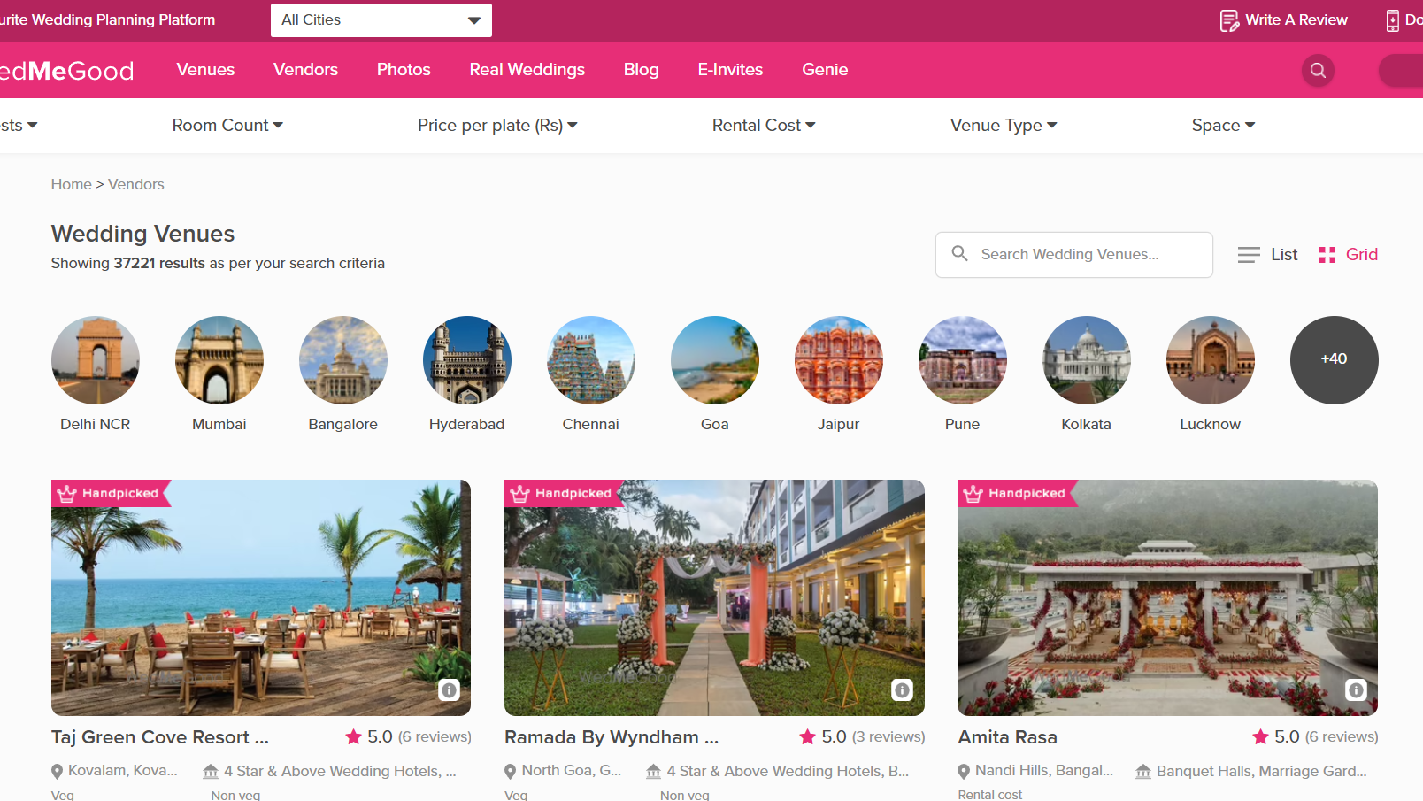

Slide 14
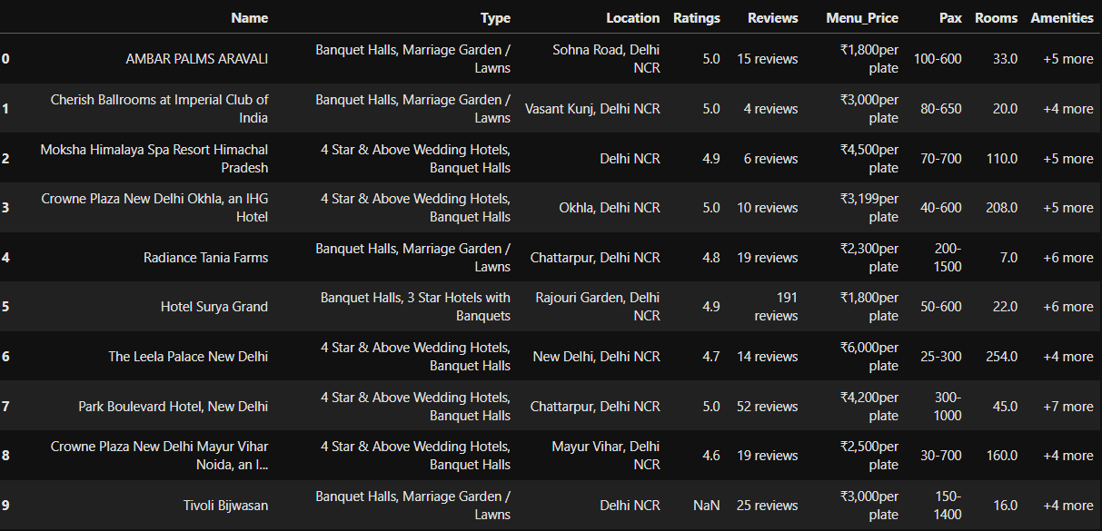
AFTER SCRAPPING / BEFORE EDA DATAFRAME

Slide 15
AFTER SCRAPPING / BEFORE EDA DATAFRAME

Slide 16
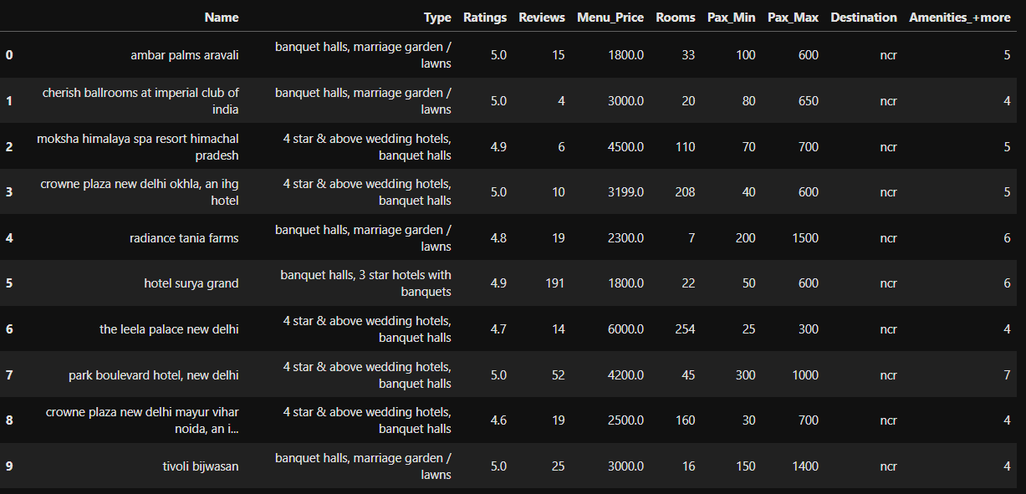
AFTER EDA DATAFRAME

Slide 17
AFTER EDA DATAFRAME

Slide 18
DIVISION OF FEATURES
Numerical Columns:
Ratings : Defines the number of ratings.
Reviews : Defines the number of reviews.
Menu Price : Shows the prices in INR.
Rooms : Defines the number of rooms.
Pax Min : Shows the number minimum persons/passengers.
Pax Max : Shows the number maximum persons/passengers.
Amenities +More : Defines how many more services are available
Categorical Columns:
Name : Defines all the names of the venues.
Type : Contains all data about which type of hall/halls it has.
Destination : Shows where the venue is.

Slide 19
DIVISION OF FEATURES
Numerical Columns:
Ratings : Defines the number of ratings.
Reviews : Defines the number of reviews.
Menu Price : Shows the prices in INR.
Rooms : Defines the number of rooms.
Pax Min : Shows the number minimum persons/passengers.
Pax Max : Shows the number maximum persons/passengers.
Amenities +More : Defines how many more services are available
Categorical Columns:
Name : Defines all the names of the venues.
Type : Contains all data about which type of hall/halls it has.
Destination : Shows where the venue is.

Slide 20
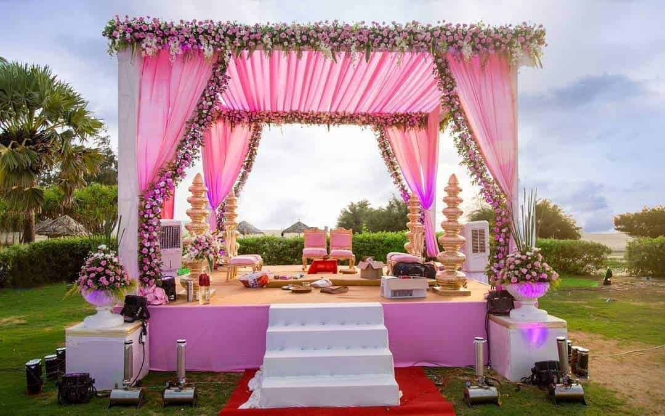
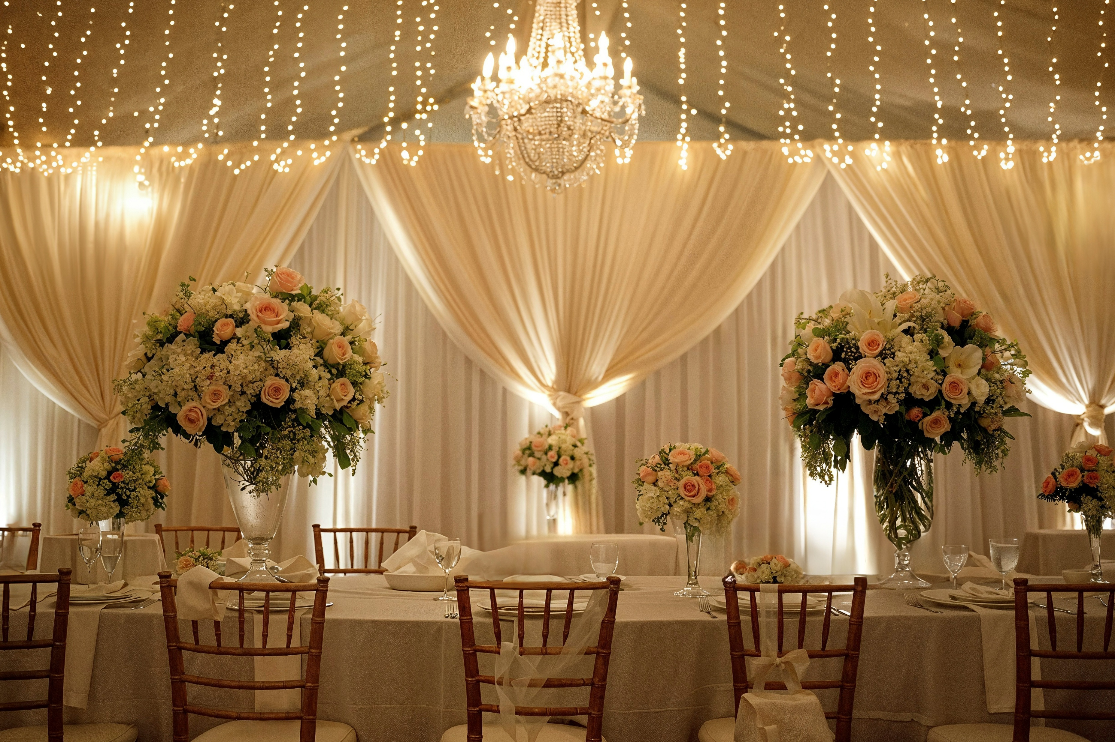
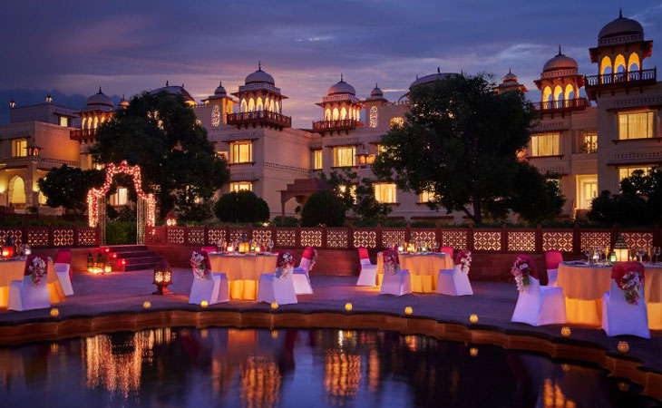
TYPES OF VENUES
Banquet Halls
Marriage Garden /Lawns3 Star Hotels
4 Star & Above Wedding Hotels
5 Star Luxury Wedding Hotels
Kalyana Mandapams
Convention / Function Halls
Venues with Rooms
Party Restaurants / Lounge Bars
Wedding Farmhouses
Small Function / Party Halls
Wedding Resorts
Destination Wedding Venues
Forts / Palaces for Wedding

Slide 21
TYPES OF VENUES
Banquet Halls
Marriage Garden /Lawns3 Star Hotels
4 Star & Above Wedding Hotels
5 Star Luxury Wedding Hotels
Convention / Function Halls
Party Restaurants / Lounge Bars
Wedding Farmhouses
Small Function / Party Halls
Wedding Resorts
Destination Wedding Venues
Forts / Palaces for Wedding

Slide 22
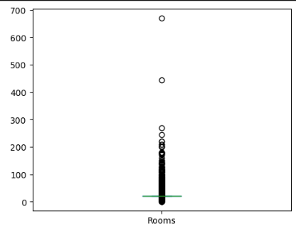
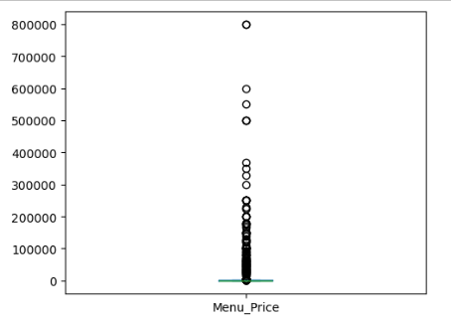
UNIVARIATE GRAPHS ON NUMERICAL COLUMNS

Slide 23
UNIVARIATE GRAPHS ON NUMERICAL COLUMNS

Slide 24
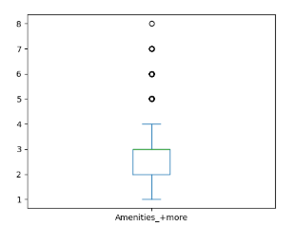
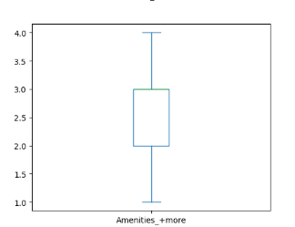
BEFORE HANDLING
OUTLIERS
AFTER HANDLING
OUTLIERS

Slide 25
BEFORE HANDLING
OUTLIERS
AFTER HANDLING
OUTLIERS

Slide 26
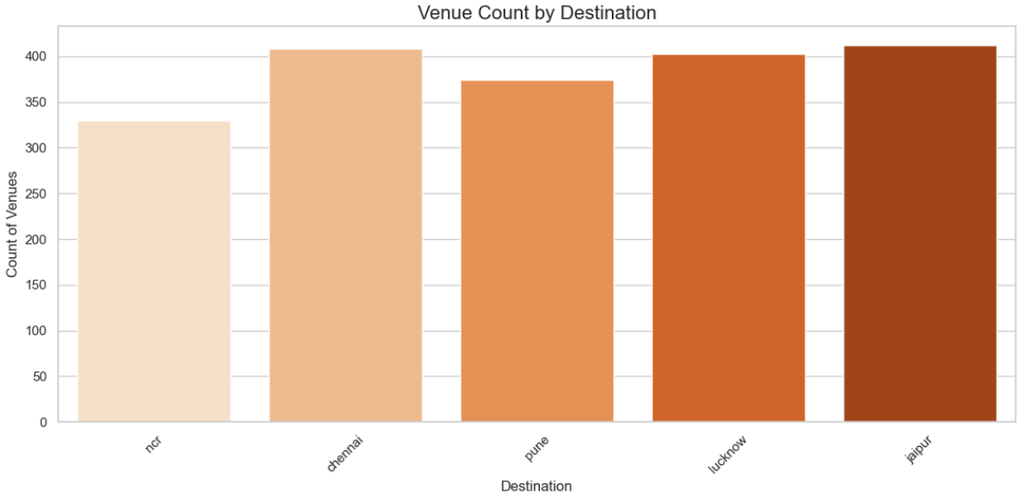
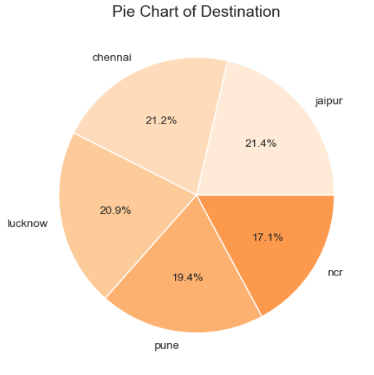
COUNT OF VENUES BY
DESTINATION

Slide 27
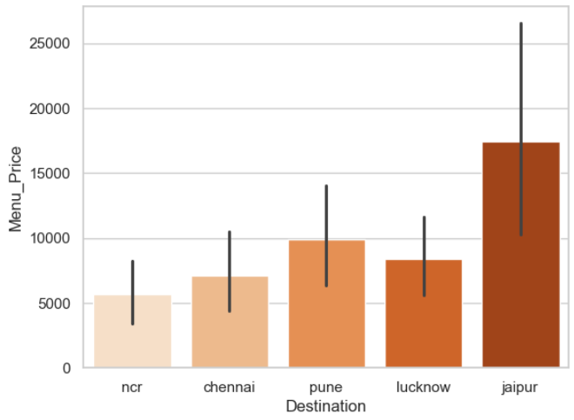
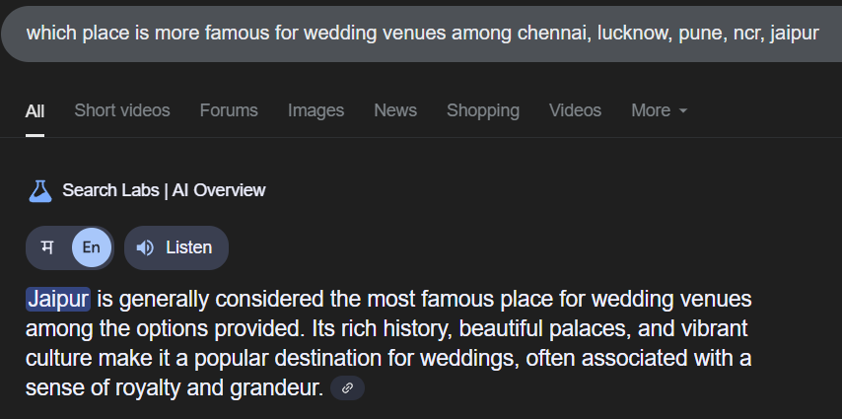
BIVARIATE ANALYSIS ON DESTINATION VS MENU PRICE

Slide 28
BIVARIATE ANALYSIS ON DESTINATION VS MENU PRICE

Slide 29
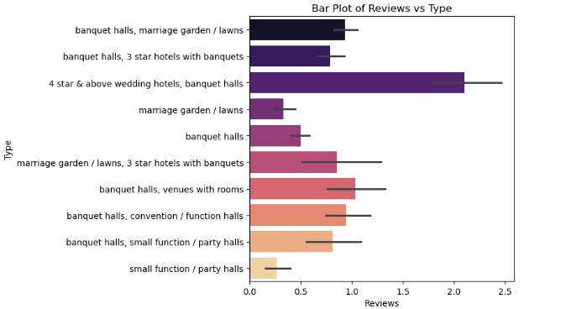
BIVARIATE ANALYSIS ON REVIEWS VS TYPE

Slide 30
BIVARIATE ANALYSIS ON REVIEWS VS TYPE

Slide 31
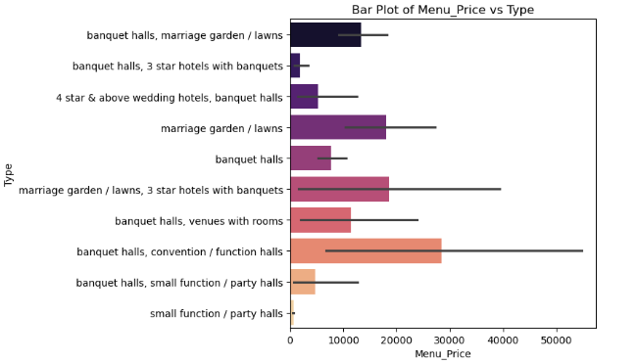
BIVARIATE ANALYSIS ON MENU PRICE VS TYPE

Slide 32
BIVARIATE ANALYSIS ON MENU PRICE VS TYPE

Slide 33
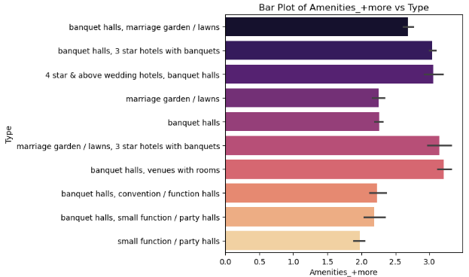
BIVARIATE ANALYSIS ON AMENITIES VS TYPE

Slide 34
BIVARIATE ANALYSIS ON AMENITIES VS TYPE

Slide 35
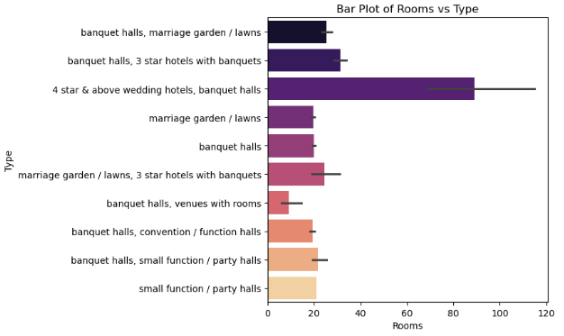
BIVARIATE ANALYSIS ON ROOMS VS TYPE

Slide 36
BIVARIATE ANALYSIS ON ROOMS VS TYPE

Slide 37
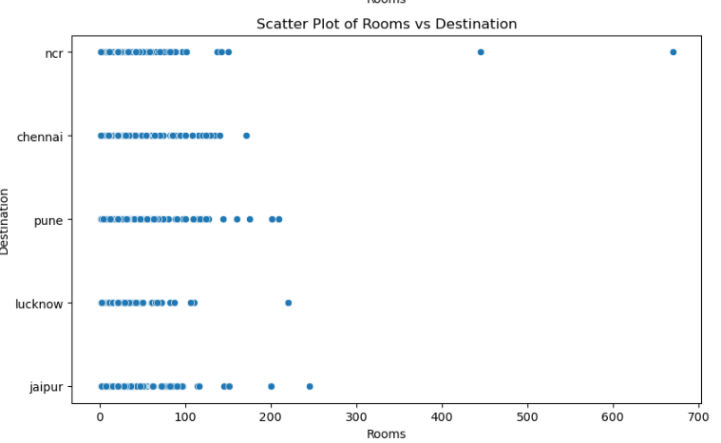
BIVARIATE ANALYSIS ON ROOMS VS DESTINATION

Slide 38
BIVARIATE ANALYSIS ON ROOMS VS DESTINATION

Slide 39
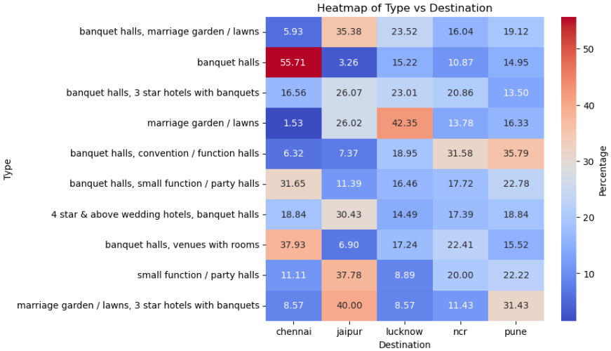
HEATMAP ON DESTINATION VS TYPE

Slide 40
HEATMAP ON DESTINATION VS TYPE

Slide 41
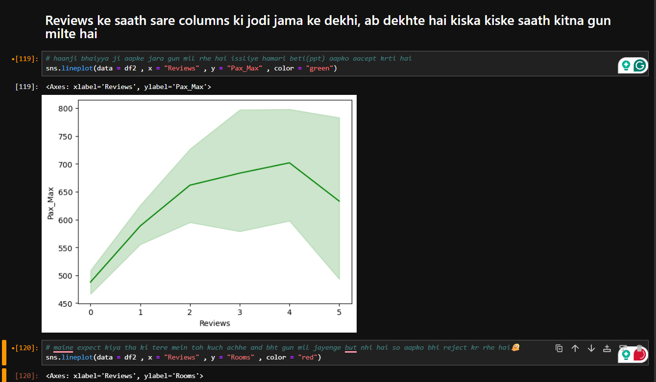

Slide 42
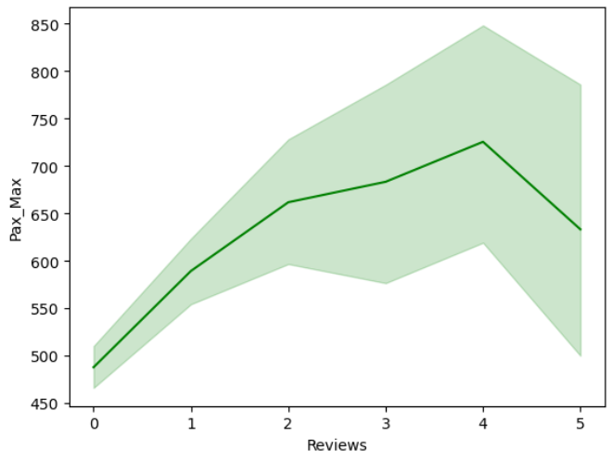
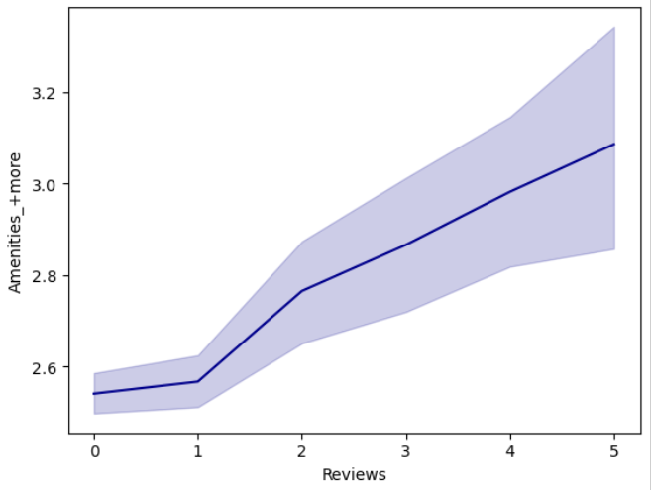
BIVARIATE ANALYSIS ON
REVIEWS VS PAX MAX
BIVARIATE ANALYSIS ON
REVIEWS VS AMENITIES

Slide 43
BIVARIATE ANALYSIS ON
REVIEWS VS PAX MAX
BIVARIATE ANALYSIS ON
REVIEWS VS AMENITIES

Slide 44
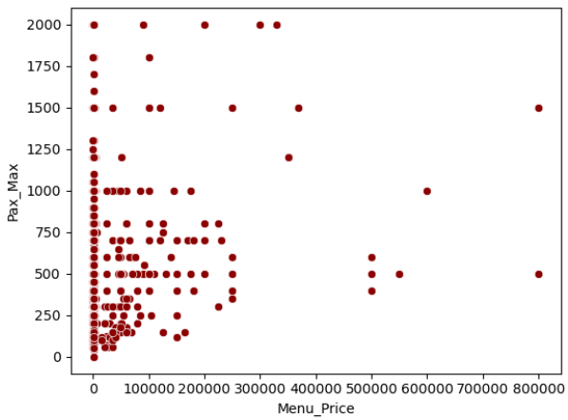
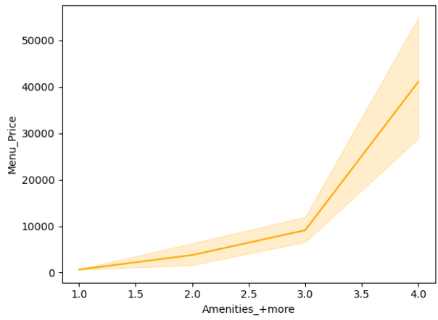
BIVARIATE ANALYSIS ON
MENU PRICE VS PAX MAX
BIVARIATE ANALYSIS ON
MENU PRICE VS AMENITIES

Slide 45
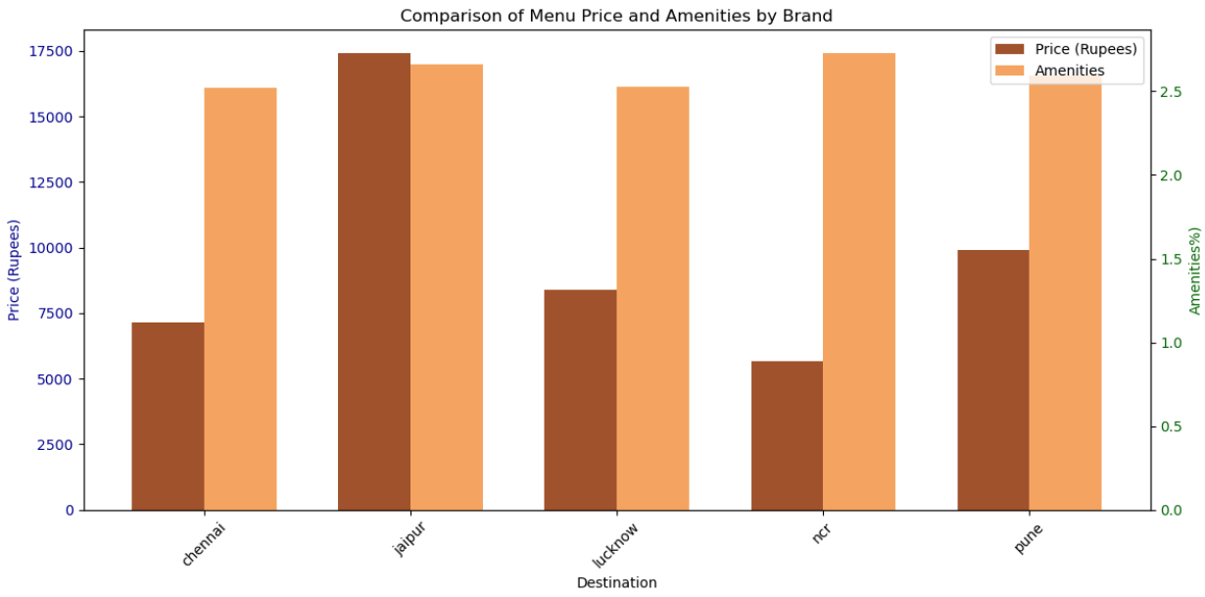
GROUP BAR PLOT OF PRICE AND AMENITIES BY DESTINATION

Slide 46
GROUP BAR PLOT OF PRICE AND AMENITIES BY DESTINATION

Slide 47
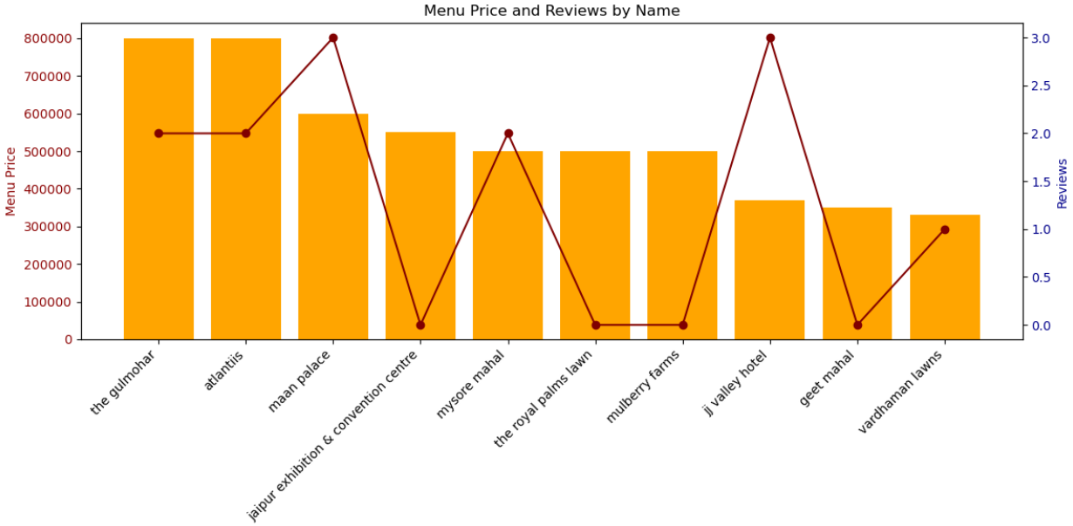
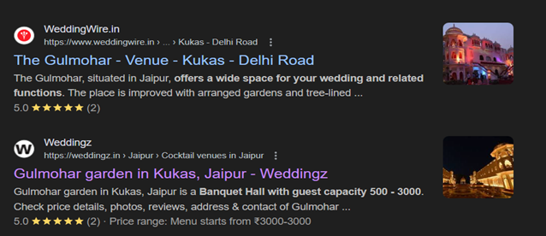
COMBO CHART OF MENU PRICE AND REVIEWS BY NAMES

Slide 48
COMBO CHART OF MENU PRICE AND REVIEWS BY NAMES

Slide 49
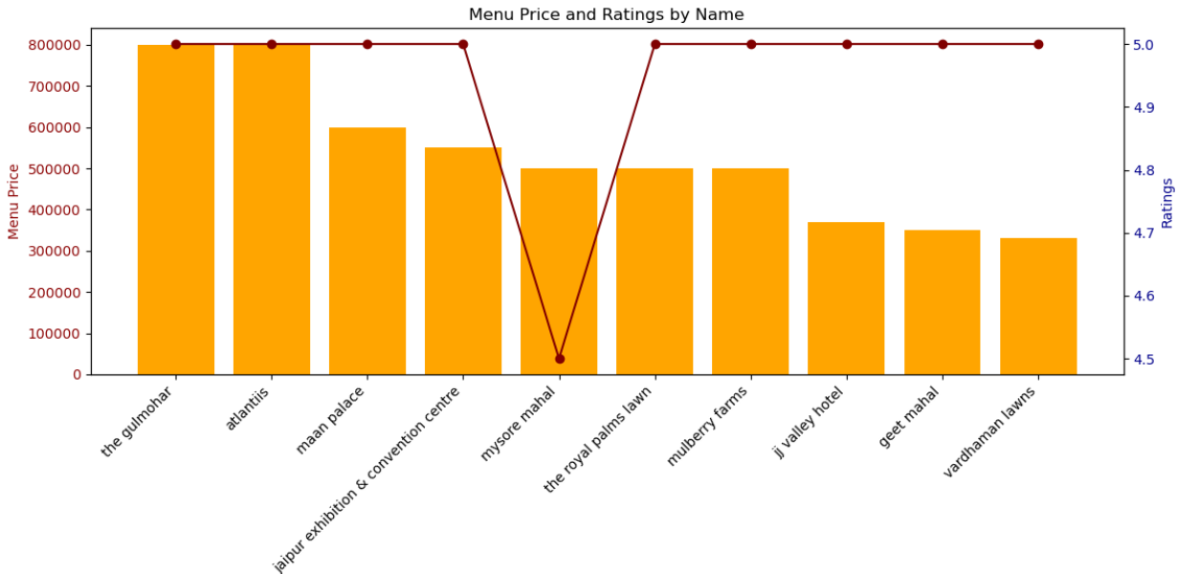

Slide 51

LET’S ALSO LOOK , WHAT YOU GUYS THINK!!
SCAN ME

Slide 52
LET’S ALSO LOOK , WHAT YOU GUYS THINK!!
SCAN ME

Slide 53
CONCLUSION
High Price != High Reviews :Venues like Atlantis and The Gulmohar have high menu prices but not proportionately high reviews.
Popular Venues Offer Balance: Venues like Mysore Mahal and Maan Palace strike a decent balance between cost and popularity, making them optimal choices for users looking for both affordability and credibility.
Amenities & Destination Correlation: More urban or premium destinations show a positive correlation between higher amenities and pricing, but not always with reviews.
Final Thought:
A smart wedding venue choice isn’t just about spending more — it’s about finding the sweet spot where value, experience, and visibility meet.

Slide 54
CONCLUSION
High Price != High Reviews :Venues like Atlantis and The Gulmohar have high menu prices but not proportionately high reviews.
Popular Venues Offer Balance: Venues like Mysore Mahal and Maan Palace strike a decent balance between cost and popularity, making them optimal choices for users looking for both affordability and credibility.
Amenities & Destination Correlation: More urban or premium destinations show a positive correlation between higher amenities and pricing, but not always with reviews.
Final Thought:
A smart wedding venue choice isn’t just about spending more — it’s about finding the sweet spot where value, experience, and visibility meet.

Slide 55
DOES ANYONE HAVE ANY QUESTIONS?
OR
ANY SUGGESTIONS?

Slide 56
THESE DESTINATIONS AND VENUES YOU PREFER ACCORDING TO YOUR BUDGET :
Destination | Low Price Venue | Medium Price Venue | High Price Venue
NCR | Hotel Surya Grand | Radiance Tania Farms | The Leela Palace New Delhi
Pune | The Royals Banquet Hall | Siddhi Banquets | Conrad Pune
Jaipur | Shree Garden Marriage Hall | Nandini Grand Palace | The Gulmohar
Chennai | Meenakshi Mandapam | Sangam Banquet Hall | ITC Grand Chola
Lucknow | Golden Palace Lawn | Milan Banquet Hall | Taj Mahal Hotel, Lucknow

Slide 57
THANK YOU !!

Slide 58
THANK YOU !!

